Slide 1
Networking Technologies
AICT012-4-2 and Version VE3
Transport Layer

Slide 2
Topic & Structure of The Lesson
Topic Title | Topic Objective
Transportation of Data | Explain the purpose of the transport layer in managing the transportation of data in end-to-end communication.
TCP Overview | Explain characteristics of TCP.
UDP Overview | Explain characteristics of UDP.
Port Numbers | Explain how TCP and UDP use port numbers.
TCP Communication Process | Explain how TCP session establishment and termination processes facilitate reliable communication.
Reliability and Flow Control | Explain how TCP protocol data units are transmitted and acknowledged to guarantee delivery.
UDP Communication | Compare the operations of transport layer protocols in supporting end-to-end communication.

Slide 3
Learning Outcomes
At the end of this topic, You should be able to:
Describe the purpose of the transport layer in managing the transportation of data in end-to-end communication.
Describe characteristics of the TCP and UDP protocols, including port numbers and their uses.
Explain how TCP session establishment and termination processes facilitate reliable communication.
Explain how TCP protocol data units are transmitted and acknowledged to guarantee delivery.
Describe the UDP client processes to establish communication with a server.
Compare UDP and TCP.

Slide 4
Key Terms You Must Be Able To Use
If you have mastered this topic, you should be able to use the following terms correctly in your assignments and exams:
transport layer
connection-oriented
connectionless
acknowledgement
flow control
three way handshake
datagram
Transmission control protocol (TCP)
User datagram protocol (UDP)

Slide 5
10.1 Transportation of data
Notes:
Cisco Networking Academy Program
Introduction to Networks v7.0
Chapter 14: Transport Layer

Slide 6
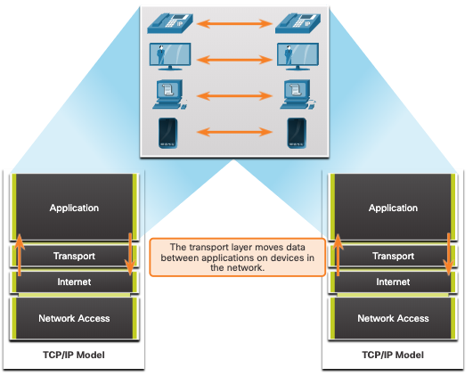
Transportation of Data Role of the Transport Layer
The transport layer is:
Responsible for logical communications between applications running on different hosts.
The link between the application layer and the lower layers that are responsible for network transmission.
Notes:
14 –Transport Layer
14.1 - Transportation of Data
14.1.1 – Role of the Transport Layer

Slide 7
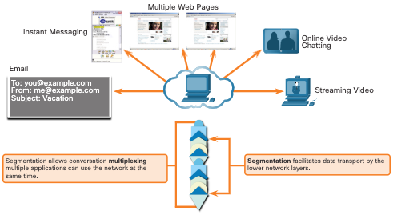
Transportation of Data Transport Layer Responsibilities
The transport layer has the following responsibilities:
Tracking individual conversations
Segmenting data and reassembling segments
Adds header information
Identify, separate, and manage multiple conversations
Uses segmentation and multiplexing to enable different communication conversations to be interleaved on the same network
Notes:
14 –Transport Layer
14.1 - Transportation of Data
14.1.2 – Transport Layer Responsibilities

Slide 8
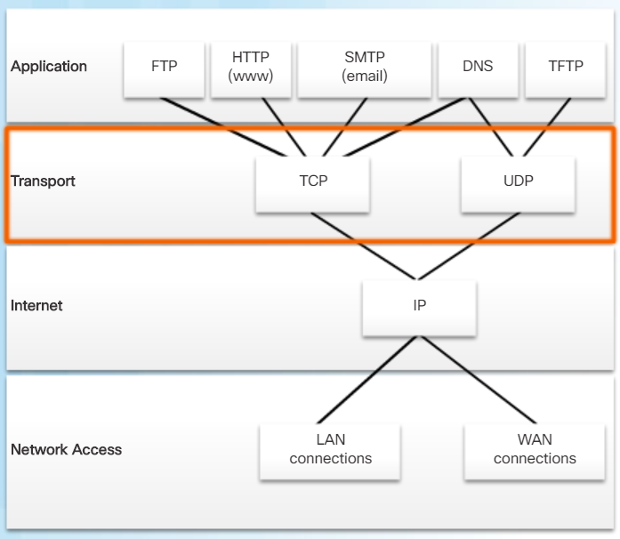
Transportation of Data Transport Layer Protocols
IP does not specify how the delivery or transportation of the packets takes place.
Transport layer protocols specify how to transfer messages between hosts, and are responsible for managing reliability requirements of a conversation.
The transport layer includes the TCP and UDP protocols.
Notes:
14 –Transport Layer
14.1 - Transportation of Data
14.1.3 – Transport Layer Protocols

Slide 9
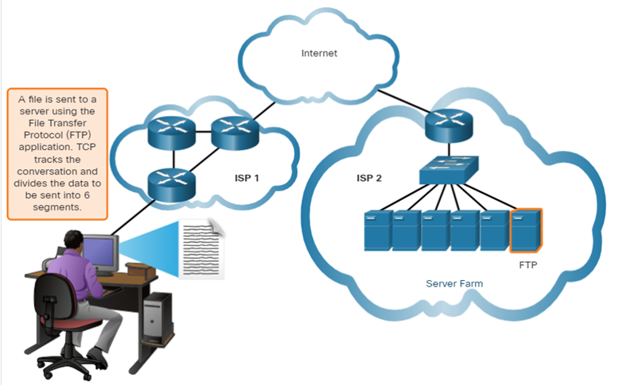
Transportation of Data Transmission Control Protocol
TCP provides reliability and flow control. TCP basic operations:
Number and track data segments transmitted to a specific host from a specific application
Acknowledge received data
Retransmit any unacknowledged data after a certain amount of time
Sequence data that might arrive in wrong order
Send data at an efficient rate that is acceptable by the receiver
Notes:
14 –Transport Layer
14.1 - Transportation of Data
14.1.4 – Transmission Control Protocol (TCP)

Slide 10
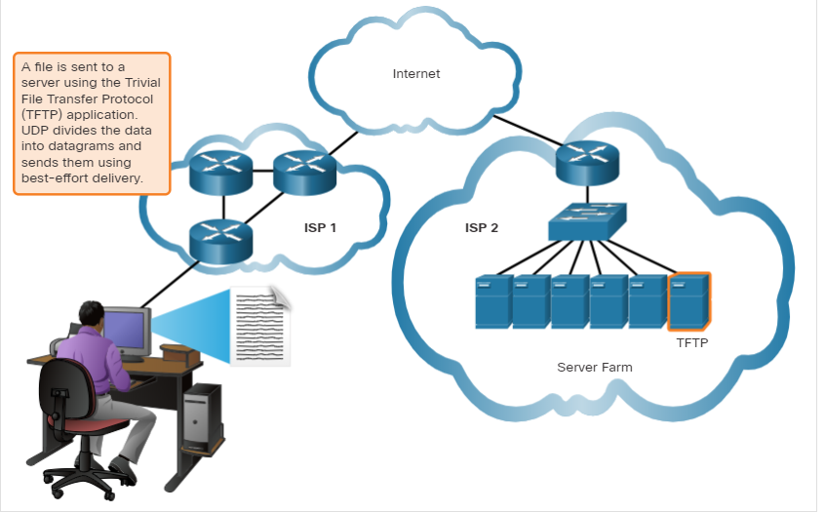
Transportation of Data User Datagram Protocol (UDP)
UDP provides the basic functions for delivering datagrams between the appropriate applications, with very little overhead and data checking.
UDP is a connectionless protocol.
UDP is known as a best-effort delivery protocol because there is no acknowledgment that the data is received at the destination.
Notes:
14 –Transport Layer
14.1 - Transportation of Data
14.1.5 – User Datagram Protocol (UDP)

Slide 11
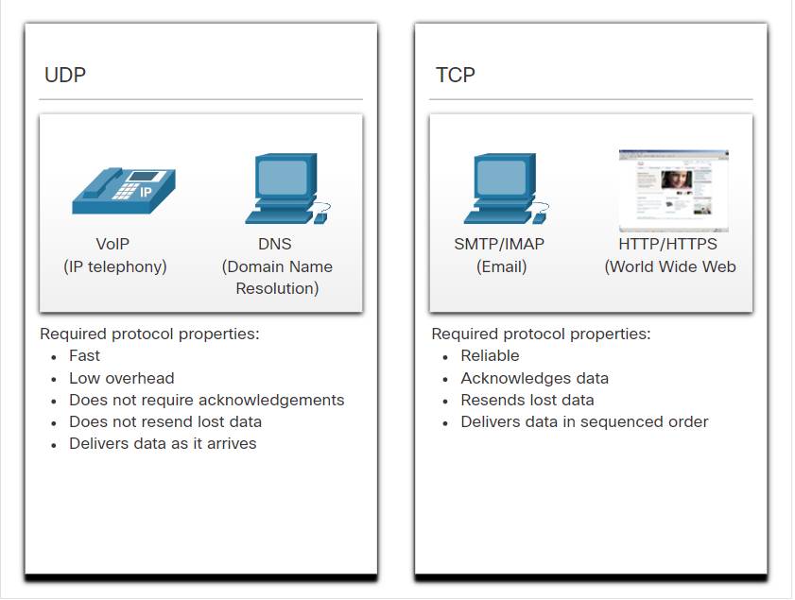
Transportation of Data The Right Transport Layer Protocol for the Right Application
UDP is also used by request-and-reply applications where the data is minimal, and retransmission can be done quickly.
If it is important that all the data arrives and that it can be processed in its proper sequence, TCP is used as the transport protocol.
Notes:
14 –Transport Layer
14.1 - Transportation of Data
14.1.6 – The Right Transport Layer Protocol for the Right Application
14.1.7 – Check your Understanding- Transportation of Data

Slide 12
Check your understanding – 10.1 Transportation of Data

Slide 13
10.2 TCP Overview
Notes:
Cisco Networking Academy Program
Introduction to Networks v7.0
Chapter 14: Transport Layer

Slide 14
TCP Overview TCP Features
Establishes a Session - TCP is a connection-oriented protocol that negotiates and establishes a permanent connection (or session) between source and destination devices prior to forwarding any traffic.
Ensures Reliable Delivery - For many reasons, it is possible for a segment to become corrupted or lost completely, as it is transmitted over the network. TCP ensures that each segment that is sent by the source arrives at the destination.
Provides Same-Order Delivery - Because networks may provide multiple routes that can have different transmission rates, data can arrive in the wrong order.
Supports Flow Control - Network hosts have limited resources (i.e., memory and processing power). When TCP is aware that these resources are overtaxed, it can request that the sending application reduce the rate of data flow.
Notes:
14 – Transport Layer
14.2 – TCP Overview
14.2.1 – TCP Features

Slide 15
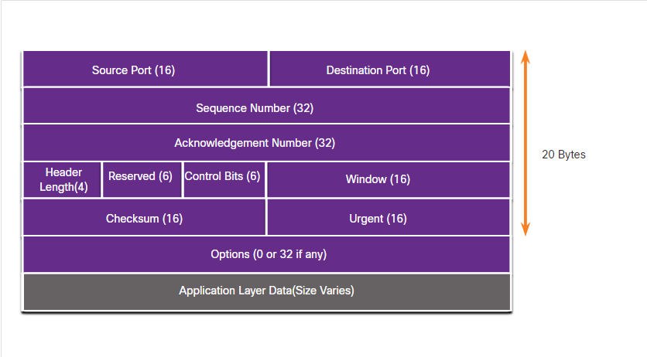
TCP Overview TCP Header
TCP is a stateful protocol which means it keeps track of the state of the communication session.
TCP records which information it has sent, and which information has been acknowledged.
Notes:
14 – Transport Layer
14.2 – TCP Overview
14.2.2 – TCP Header

Slide 16
TCP Overview TCP Header Fields
TCP Header Field | Description
Source Port | A 16-bit field used to identify the source application by port number.
Destination Port | A 16-bit field used to identify the destination application by port number.
Sequence Number | A 32-bit field used for data reassembly purposes.
Acknowledgment Number | A 32-bit field used to indicate that data has been received and the next byte expected from the source.
Header Length | A 4-bit field known as ʺdata offsetʺ that indicates the length of the TCP segment header.
Reserved | A 6-bit field that is reserved for future use.
Control bits | A 6-bit field used that includes bit codes, or flags, which indicate the purpose and function of the TCP segment.
Window size | A 16-bit field used to indicate the number of bytes that can be accepted at one time.
Checksum | A 16-bit field used for error checking of the segment header and data.
Urgent | A 16-bit field used to indicate if the contained data is urgent.
Notes:
14 – Transport Layer
14.2 – TCP Overview
14.2.3 – TCP Header

Slide 17
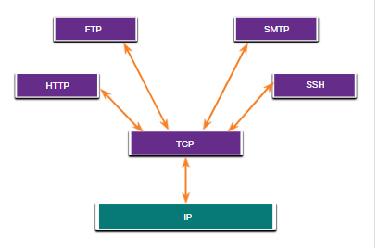
TCP Overview Applications that use TCP
TCP handles all tasks associated with dividing the data stream into segments, providing reliability, controlling data flow, and reordering segments.
Notes:
14 – Transport Layer
14.2 – TCP Overview
14.2.4 – Applications that use TCP
14.2.5 Check your Understanding – TCP Overview

Slide 18
Check your understanding – 10.2 TCP Overview

Slide 19
10.3 UDP Overview
Notes:
Cisco Networking Academy Program
Introduction to Networks v7.0
Chapter 14: Transport Layer

Slide 20
UDP Overview UDP Features
UDP features include the following:
Data is reconstructed in the order that it is received.
Any segments that are lost are not resent.
There is no session establishment.
The sending is not informed about resource availability.
Notes:
14 – Transport Layer
14.3 – UDP Overview
14.3.1 – UDP Features

Slide 21
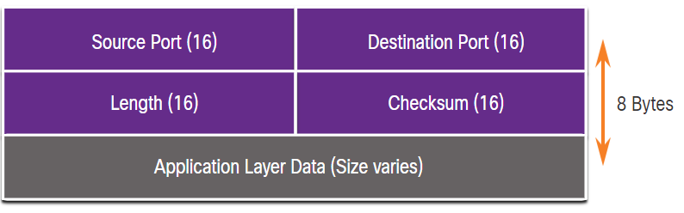
UDP Overview UDP Header
The UDP header is far simpler than the TCP header because it only has four fields and requires 8 bytes (i.e. 64 bits).
Notes:
14 – Transport Layer
14.3 – UDP Overview
14.3.2 – UDP Header

Slide 22
UDP Overview UDP Header Fields
The table identifies and describes the four fields in a UDP header.
UDP Header Field | Description
Source Port | A 16-bit field used to identify the source application by port number.
Destination Port | A 16-bit field used to identify the destination application by port number.
Length | A 16-bit field that indicates the length of the UDP datagram header.
Checksum | A 16-bit field used for error checking of the datagram header and data.
Notes:
14 – Transport Layer
14.3 – UDP Overview
14.3.3 - UDP Header Fields

Slide 23
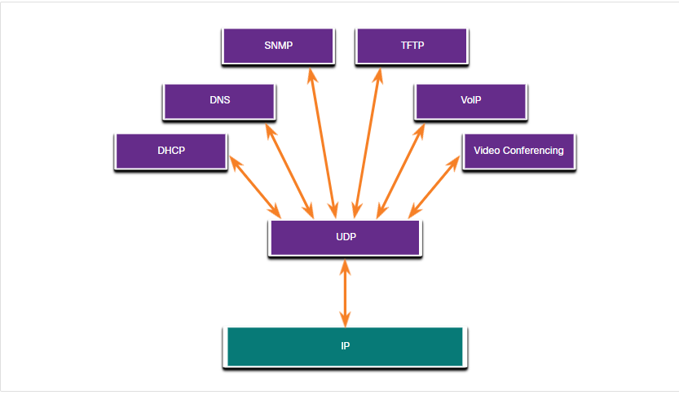
UDP Overview Applications that use UDP
Live video and multimedia applications - These applications can tolerate some data loss but require little or no delay. Examples include VoIP and live streaming video.
Simple request and reply applications - Applications with simple transactions where a host sends a request and may or may not receive a reply. Examples include DNS and DHCP.
Applications that handle reliability themselves - Unidirectional communications where flow control, error detection, acknowledgments, and error recovery is not required, or can be handled by the application. Examples include SNMP and TFTP.
Notes:
14 – Transport Layer
14.3 – UDP Overview
14.3.4 – Applications that use UDP
14.3.5 - Check Your Understanding – UDP Overview

Slide 24
Check your understanding – 10.3 UDP Overview

Slide 25
10.4 Port Numbers
Notes:
Cisco Networking Academy Program
Introduction to Networks v7.0
Chapter 14: Transport Layer

Slide 26
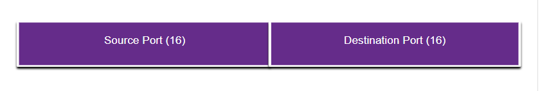
Port Numbers Multiple Separate Communications
TCP and UDP transport layer protocols use port numbers to manage multiple, simultaneous conversations.
The source port number is associated with the originating application on the local host whereas the destination port number is associated with the destination application on the remote host.
Notes:
14 – Transport Layer
14.4 – Port Numbers
14.4.1 - Multiple Separate Communications

Slide 27
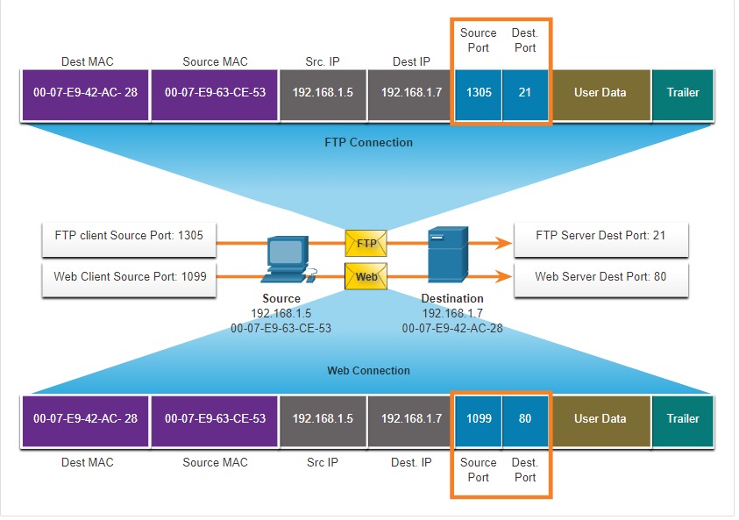
Port numbers Socket Pairs
The source and destination ports are placed within the segment.
The segments are then encapsulated within an IP packet.
The combination of the source IP address and source port number, or the destination IP address and destination port number is known as a socket.
Sockets enable multiple processes, running on a client, to distinguish themselves from each other, and multiple connections to a server process to be distinguished from each other.
Notes:
14 – Transport Layer
14.4 – Port Numbers
14.4.2 – Socket Pairs

Slide 28
Port Numbers Port Number Groups
Port Group | Number Range | Description
Well-known Ports | 0 to 1,023 | These port numbers are reserved for common or popular services and applications such as web browsers, email clients, and remote access clients. Defined well-known ports for common server applications enables clients to easily identify the associated service required.
Registered Ports | 1,024 to 49,151 | These port numbers are assigned by IANA to a requesting entity to use with specific processes or applications. These processes are primarily individual applications that a user has chosen to install, rather than common applications that would receive a well-known port number. For example, Cisco has registered port 1812 for its RADIUS server authentication process.
Private and/or Dynamic Ports | 49,152 to 65,535 | These ports are also known as ephemeral ports. The client’s OS usually assign port numbers dynamically when a connection to a service is initiated. The dynamic port is then used to identify the client application during communication.
Notes:
14 – Transport Layer
14.4 – Port Numbers
14.4.3 - Port Number Groups

Slide 29
Port Numbers Port Number Groups (Cont.)
Well-Known Port Numbers
Port Number | Protocol | Application
20 | TCP | File Transfer Protocol (FTP) - Data
21 | TCP | File Transfer Protocol (FTP) - Control
22 | TCP | Secure Shell (SSH)
23 | TCP | Telnet
25 | TCP | Simple Mail Transfer Protocol (SMTP)
53 | UDP, TCP | Domain Name Service (DNS)
67 | UDP | Dynamic Host Configuration Protocol (DHCP) - Server
68 | UDP | Dynamic Host Configuration Protocol - Client
69 | UDP | Trivial File Transfer Protocol (TFTP)
80 | TCP | Hypertext Transfer Protocol (HTTP)
110 | TCP | Post Office Protocol version 3 (POP3)
143 | TCP | Internet Message Access Protocol (IMAP)
161 | UDP | Simple Network Management Protocol (SNMP)
443 | TCP | Hypertext Transfer Protocol Secure (HTTPS)
Notes:
14 – Transport Layer
14.4 – Port Numbers
14.4.3 - Port Number Groups (Cont.)

Slide 30
Port Numbers The netstat Command
Unexplained TCP connections can pose a major security threat. Netstat is an important tool to verify connections.
C:\> netstat
Active Connections
Proto Local Address Foreign Address State
TCP 192.168.1.124:3126 192.168.0.2:netbios-ssn ESTABLISHED
TCP 192.168.1.124:3158 207.138.126.152:http ESTABLISHED
TCP 192.168.1.124:3159 207.138.126.169:http ESTABLISHED
TCP 192.168.1.124:3160 207.138.126.169:http ESTABLISHED
TCP 192.168.1.124:3161 sc.msn.com:http ESTABLISHED
TCP 192.168.1.124:3166 www.cisco.com:http ESTABLISHED
Notes:
14 – Transport Layer
14.4 – Port Numbers
14.4.4 - The netstat Command
14.4.5 – Check Your Understanding – Port Numbers

Slide 31
Check your understanding – 10.4 Port Numbers

Slide 32
10.5 TCP Communication Process
Notes:
Cisco Networking Academy Program
Introduction to Networks v7.0
Chapter 14: Transport Layer

Slide 33
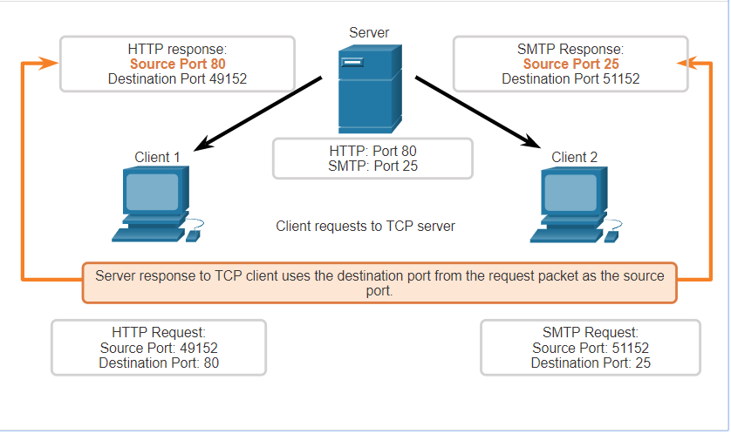
TCP Communication Process TCP Server Processes
Each application process running on a server is configured to use a port number.
An individual server cannot have two services assigned to the same port number within the same transport layer services.
An active server application assigned to a specific port is considered open, which means that the transport layer accepts, and processes segments addressed to that port.
Any incoming client request addressed to the correct socket is accepted, and the data is passed to the server application.
Notes:
14 – Transport Layer
14.5 – TCP Communication Process
14.5.1 – TCP Server Processes

Slide 34
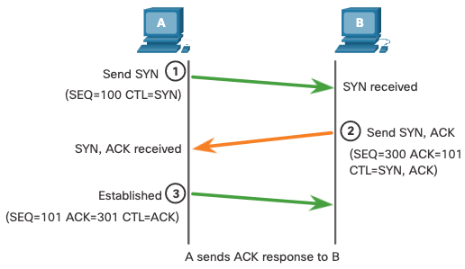
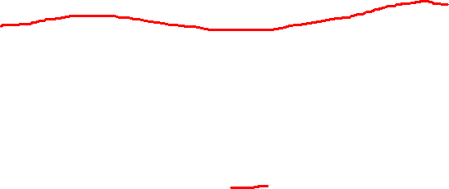
TCP Communication Process TCP Connection Establishment
Step 1: The initiating client requests a client-to-server communication session with the server.
Step 2: The server acknowledges the client-to-server communication session and requests a server-to-client communication session.
Step 3: The initiating client acknowledges the server-to-client communication session.
Notes:
14 – Transport Layer
14.5 – TCP Communication Process
14.5.2 – TCP Connection Establishment

Slide 35
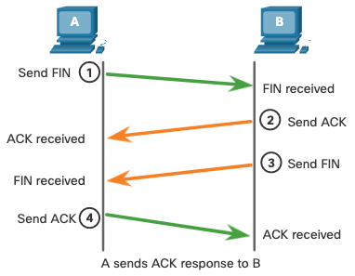

TCP Communication Process Session Termination
Step 1: When the client has no more data to send in the stream, it sends a segment with the FIN flag set.
Step 2: The server sends an ACK to acknowledge the receipt of the FIN to terminate the session from client to server.
Step 3: The server sends a FIN to the client to terminate the server-to-client session.
Step 4: The client responds with an ACK to acknowledge the FIN from the server.
Notes:
14 – Transport Layer
14.5 – TCP Communication Process
14.5.3 – Session Termination

Slide 36
Video – TCP 3 Way Handshake

Slide 37
TCP Communication Process TCP Three-Way Handshake Analysis
Functions of the Three-Way Handshake:
It establishes that the destination device is present on the network.
It verifies that the destination device has an active service and is accepting requests on the destination port number that the initiating client intends to use.
It informs the destination device that the source client intends to establish a communication session on that port number.
After the communication is completed the sessions are closed, and the connection is terminated. The connection and session mechanisms enable TCP reliability function.
Notes:
14 – Transport Layer
14.5 – TCP Communication Process
14.5.4 – Three-way Handshake Establishment

Slide 38
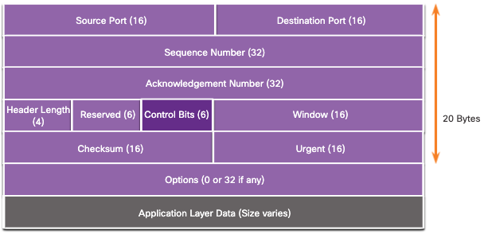

TCP Communication Process TCP Three-Way Handshake Analysis (Cont.)
The six control bit flags are as follows:
URG - Urgent pointer field significant
ACK - Acknowledgment flag used in connection establishment and session termination
PSH - Push function
RST - Reset the connection when an error or timeout occurs
SYN - Synchronize sequence numbers used in connection establishment
FIN - No more data from sender and used in session termination
Notes:
14 – Transport Layer
14.5 – TCP Communication Process
14.5.4 – Three-way Handshake Analysis

Slide 39
Check your understanding – 10.5 TCP Communication Process

Slide 40
10.6 Reliability and Flow Control
Notes:
Cisco Networking Academy Program
Introduction to Networks v7.0
Chapter 14: Transport Layer

Slide 41
Video – TCP Reliability – Sequence Numbers and Acknowledgements

Slide 42
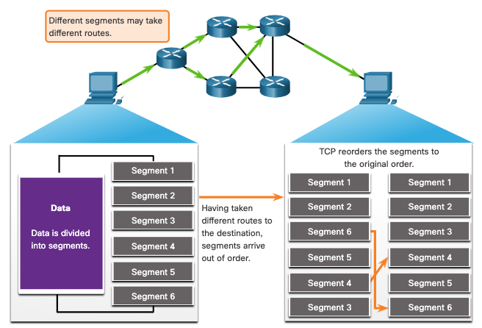
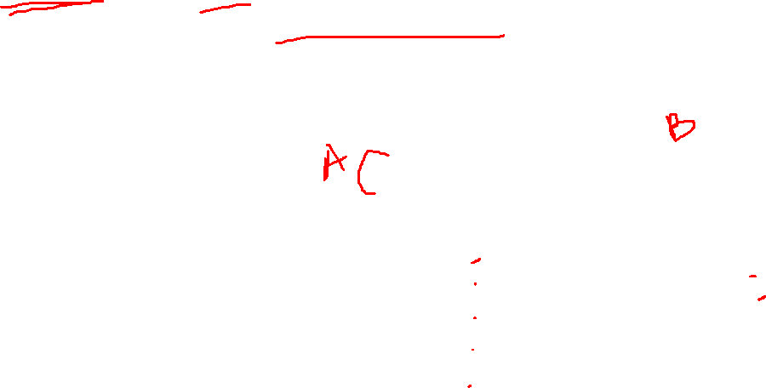
Reliability and Flow Control TCP Reliability- Guaranteed and Ordered Delivery
TCP can also help maintain the flow of packets so that devices do not become overloaded.
There may be times when TCP segments do not arrive at their destination or arrive out of order.
All the data must be received and the data in these segments must be reassembled into the original order.
Sequence numbers are assigned in the header of each packet to achieve this goal.
Notes:
14 – Transport Layer
14.6 – Reliability and Flow Control
14.6.1 – TCP Reliability – Guaranteed and Ordered Delivery

Slide 43
Video – TCP Reliability – Data Loss and Retransmission

Slide 44
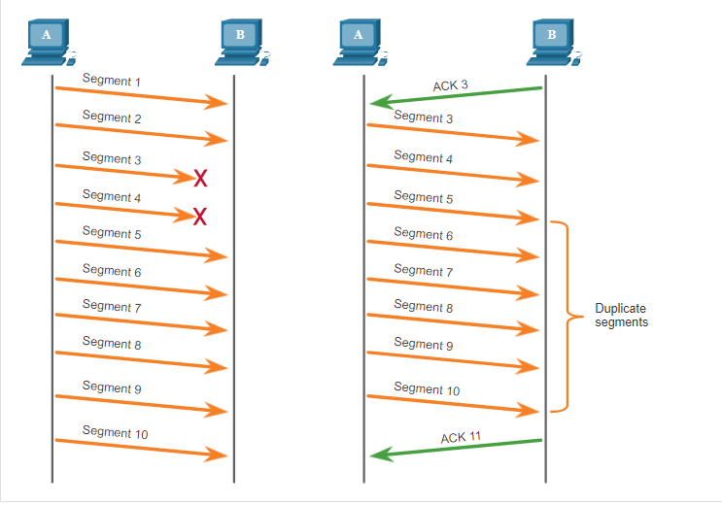
Reliability and Flow Control TCP Reliability – Data Loss and Retransmission
No matter how well designed a network is, data loss occasionally occurs.
TCP provides methods of managing these segment losses. Among these is a mechanism to retransmit segments for unacknowledged data.
Notes:
14 – Transport Layer
14.6 – Reliability and Flow Control
14.6.3 TCP Reliability – Data Loss and Transmission

Slide 45
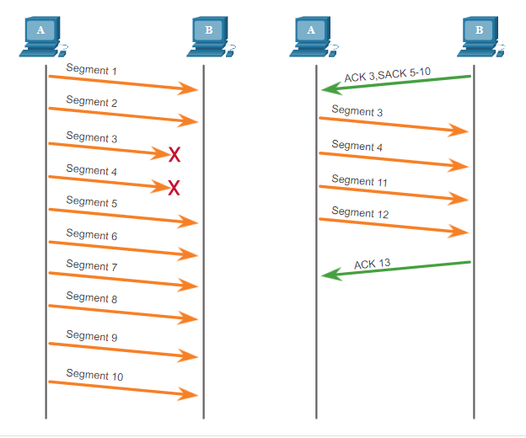
Reliability and Flow Control TCP Reliability – Data Loss and Retransmission (Cont.)
Host operating systems today typically employ an optional TCP feature called selective acknowledgment (SACK), negotiated during the three-way handshake.
If both hosts support SACK, the receiver can explicitly acknowledge which segments (bytes) were received including any discontinuous segments.
Notes:
14 – Transport Layer
14.6 – Reliability and Flow Control
14.6.3 TCP Reliability – Data Loss and Transmission (Cont.)

Slide 46
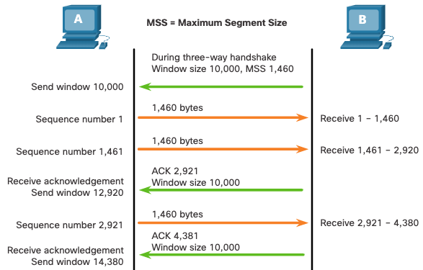
Reliability and Flow Control TCP Flow Control – Window Size and Acknowledgments
TCP also provides mechanisms for flow control as follows:
Flow control is the amount of data that the destination can receive and process reliably.
Flow control helps maintain the reliability of TCP transmission by adjusting the rate of data flow between source and destination for a given session.
Notes:
14 – Transport Layer
14.6 – Reliability and Flow Control
14.6.5 – TCP Flow Control – Window Size and Acknowledgments

Slide 47
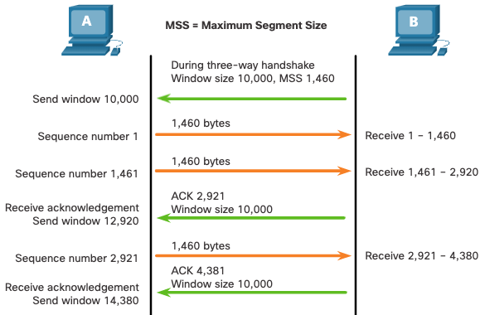
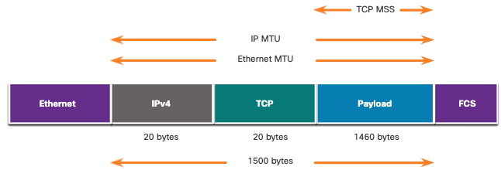
Reliability and Flow Control TCP Flow Control – Maximum Segment Size
Maximum Segment Size (MSS) is the maximum amount of data that the destination device can receive.
A common MSS is 1,460 bytes when using IPv4.
A host determines the value of its MSS field by subtracting the IP and TCP headers from the Ethernet maximum transmission unit (MTU), which is 1500 bytes be default.
1500 minus 60 (20 bytes for the IPv4 header and 20 bytes for the TCP header) leaves 1460 bytes.
Notes:
14 – Transport Layer
14.6 – Reliability and Flow Control
14.6.6 – TCP Flow Control – Maximum Segment Size (MSS)

Slide 48
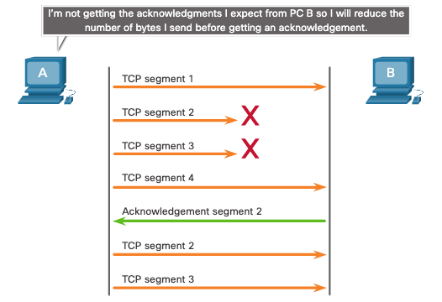
Reliability and Flow Control TCP Flow Control – Congestion Avoidance
When congestion occurs on a network, it results in packets being discarded by the overloaded router.
To avoid and control congestion, TCP employs several congestion handling mechanisms, timers, and algorithms.
Notes:
14 – Transport Layer
14.6 – Reliability and Flow Control
14.6.7 – TCP Flow Control – Congestion Avoidance
14.6.8 – Check you Understanding – Reliability and Flow Control

Slide 49
Check your understanding – 10.6 Reliability and Flow Control

Slide 50
10.7 UDP Communication
Notes:
Cisco Networking Academy Program
Introduction to Networks v7.0
Chapter 14: Transport Layer

Slide 51
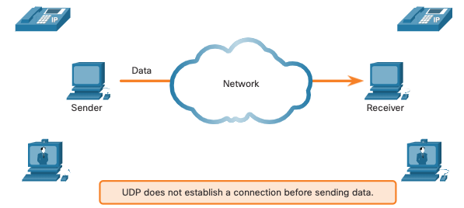
UDP Communication UDP Low Overhead versus Reliability
UDP does not establish a connection. UDP provides low overhead data transport because it has a small datagram header and no network management traffic.
Notes:
14 – Transport Layer
14.7 - UDP Communication
14.7.1 - UDP Low Overhead versus Reliability

Slide 52
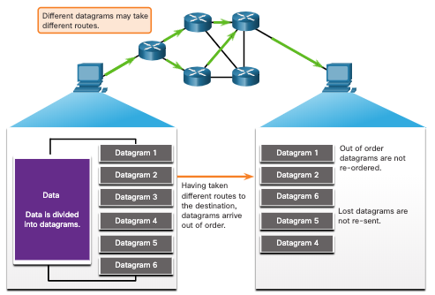
UDP Communication UDP Datagram Reassembly
UDP does not track sequence numbers the way TCP does.
UDP has no way to reorder the datagrams into their transmission order.
UDP simply reassembles the data in the order that it was received and forwards it to the application.
Notes:
14 – Transport Layer
14.7 - UDP Communication
14.7.2 – UDP Datagram Reassembly

Slide 53
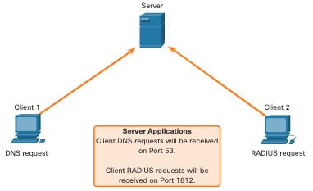
UDP Communication UDP Server Processes and Requests
UDP-based server applications are assigned well-known or registered port numbers.
UDP receives a datagram destined for one of these ports, it forwards the application data to the appropriate application based on its port number.
Notes:
14 – Transport Layer
14.7 - UDP Communication
14.7.3 – UDP Server Processes and Requests

Slide 54
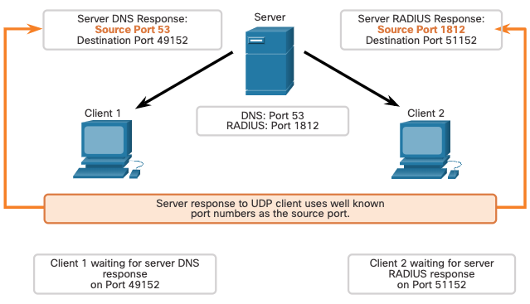
UDP Communication UDP Client Processes
The UDP client process dynamically selects a port number from the range of port numbers and uses this as the source port for the conversation.
The destination port is usually the well-known or registered port number assigned to the server process.
After a client has selected the source and destination ports, the same pair of ports are used in the header of all datagrams in the transaction.
Notes:
14 – Transport Layer
14.7 - UDP Communication
14.7.4 – UDP Client Processes
14.7.5 Check Your Understanding – UDP Communication

Slide 55
Check your understanding – 10.7 UDP Communication

Slide 56
Quick Review Question
Refer to Quiz - Chapter 14 in Cisco Networking Academy platform

Slide 57
Summary of Main Teaching Points
Explain the function of Transport Layer
Differentiate between TCP and UDP protocols
Three-way handshake in TCP
Applications that using TCP and UDP

Slide 58
Question and Answer Session
Q & A

Slide 59
What we will cover next
Application Layer

Slide 60


Slide 61


